Slide 1

Gitting Started
October 27, 2026 | Nicholas Santolla
cUAS Data Scientist @ Edgesource

Slide 2
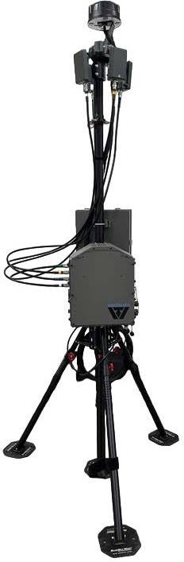
cUAS: Analytics
Counter Unmanned Aerial Systems
Detection analytics
Classification
Anomaly Detection
Sensor Fusion

Slide 3
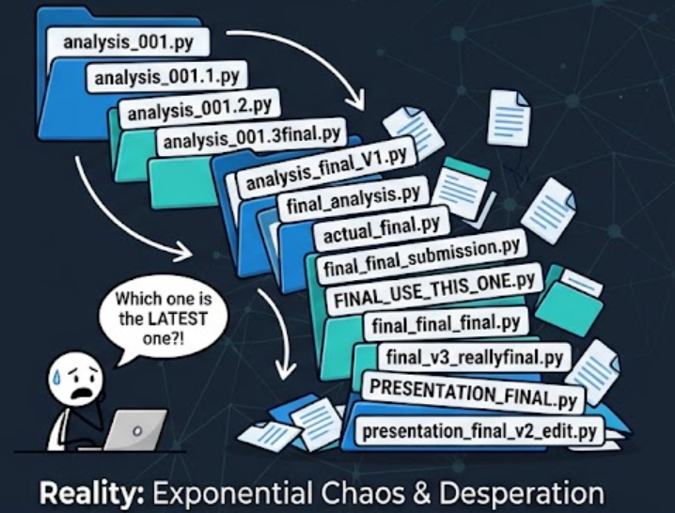
The Workflow Problem
Who has a folder that looks like this?
Notes:
can’t tell what changed between versions, can’t collaborate without overwriting someone’s work, can’t go back to “the version that worked” once you’ve already deleted it, filenames become a fake version-control system that doesn’t scale
“The filename is trying to be a version history. There’s a tool that actually does that job.”

Slide 4

What is Git?
Version Control
  Which changes were made?
  Who made the changes?
  When were the changes made?
  Why were changes needed?
Terminology
  Code is stored in a repository
  If you want to use someone else’s code and make changes, you can fork it. Then, submit a pull request to try and merge the changes back in
  Your team can work on separate branches of the same repository
  Repositories are usually initialized with a README.md, a .gitignore, and a license.
https://www.youtube.com/watch?v=w3jLJU7DT5E

Slide 5
Class Goals
Have a GitHub Account
Make a Repo
Create a branch
Commit to your Repo
Practice
Create files and add Markdown
Do a Pull Request
Merge Changes
Get GitHub CLI & VSCode
Clone a Repo
Git with AI

Slide 6
Commands
https://guides.github.com/introduction/git-handbook/
https://lab.github.com/githubtraining/introduction-to-github
git add
git clone
git commit
git status
git branch
git merge
git pull
git push
Track/Stages current changes that you want to be committed to the repo
Creates a local copy of a project that already exists remotely
Saves the snapshot to the project history and completes the change-tracking process
Shows the status of changes as untracked, modified, or staged
Shows the branches being worked on locally.
Merges lines of development together
Updates the local line of development with updates from its remote counterpart
Updates the remote repository with any commits made locally to a branch.

Slide 7


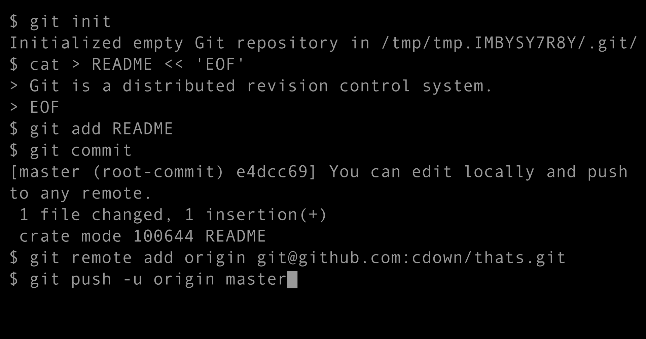





Various Tools to Git it Done
Git Clients
Repository Services

